Slide 1
Sourcing: Administration
October, 2013

Slide 2
Agenda
In this presentation we will:
  Discuss Sourcing “Administration”, which here includes:
    The initial setup of a Sourcing system
    Operational Tasks, including Importing and Exporting (in Sourcing) and Batch Uploads (in SSM)
  Optional demonstration and ad hoc exercises

Slide 3
Setting up a Sourcing System

Slide 4
Administration Overview
Administration for Sourcing is performed through a combination of tasks in SSM and in Sourcing itself.
Most of the SSM tasks would be run by someone with the SSM Administrator role, or possibly with one of the Sourcing-specific VSM roles such as “Sourcing Content Manager”.
Most Sourcing administration tasks require the Content Manager role, but some need CSM or BAM roles. It is recommended to have different users for different roles (e.g., “John BAM”, “John CM”), although an Admin user can change roles for other users (but not to or from organization-specific roles such as BAM).
    For example, the Content Manager sets up the text and recipients of messages that get sent automatically for specific triggers.
Roles in SSM and Sourcing are independent. One user could be defined as having both SSM Administrator and (Sourcing) Content Manager roles, or separate people could be responsible for the two areas.
CSM (Corporate Sourcing Manager) is responsible for most administration at the Organization level. He/she uses “Choose Customer to Manage” to switch to administer a different organization.

Slide 5
Setting up a Sourcing System
From an Implementation Team member point of view, you can assume that Emptoris has already been installed, either on-site or as hosted/SaaS
    Minimum set of components is Sourcing and SSM (Strategic Supply Management, which includes VSM (Virtual Supply Master))
Following installation, there are several Sourcing configuration tasks that can or must be performed. These are documented in the Emptoris Suite Installation Guide under the topic “Post-Installation Tasks”:
    Configure asynchronous jobs in a cluster environment
    Configure trust store for remote server connections
    Enable translation for categories
Other than the above Installation Guide discussion, there is no published documentation on other configuration that involves editing various configuration files such as siteconfig.properties. This information must be obtained from the Application Management team or Lab Services people who work closely with them.

Slide 6
Setting up a Sourcing System, cont.
A number of branding steps will usually have been done by the Emptoris Lab Services Engagement Manager. We are not covering these steps in this workshop, other than what's on this slide.
    Branding and other customizations:
        An Emptoris Sourcing customer might have thousands of suppliers. Since suppliers log in to Sourcing, most customers want their company name and logo, not IBM or Emptoris, to appear on all of the Sourcing screens, including the SSM login page.
        Prior to V10.0.1, this Branding always required a Sourcing custom build to be created. In V10.0.1 a custom build may not be needed, but a .zip file must be created. Any branding is done under an SoW with the IBM Emptoris Application Management group. Also supported are changes to colors, look and feel, customer-specific NDA or Terms and Conditions, and Supplier attachment folder names and sequence.

Slide 7
Setting up a Sourcing System, cont.
The remaining setup steps are performed by a combination of the implementation team and the customer. These are listed in the Buyer User Guide, but mostly documented in the SSM Administration Guide.
    Create Categories (done in SSM):
        Can be done by Administrators, Data Stewards, or Category Administrators
        Virtual Supply Master > Categories > Master > Create
        Data Stewards and Category Administrators can also import categories in bulk from .xls via a Batch Upload (discussed later, but note that you can't take a downloaded file, change values, and then use it for an upload)
        Hierarchy of categories is replicated to Sourcing (and other applications)
        Creation of Items in the categories takes place later, in Sourcing

Slide 8
Setting up a Sourcing System, cont.
Remaining setup steps, continued:
    Create Buyer Organizations, Business Units (Child Organizations), and Users (done in SSM):
        Buyer Organizations in Sourcing are called Internal Organizations in SSM documentation, but are called Organizations in SSM itself
        (Internal) Organizations can only be created by Administrators
        For use in Sourcing, Organizations must be Public (flow to all applications) or Restricted (flow only to named applications, including Sourcing)
        Status must be set to Active for Organization to be fully usable
    Register Supplier Organizations and create user accounts (done in SSM):
        Suppliers in Sourcing may be called External Organizations in SSM documentation, but are called Suppliers in SSM itself
        Suppliers can be created via the SSM UI, batch uploaded via SSM, or created through SLM (Supplier Lifecycle Management)
        Suppliers can be created by Administrators, Data Stewards, Data Creators
        Suppliers can optionally be Mastered, but must be Approved to make bids

Slide 9
Setting up a Sourcing System, cont.
Remaining setup steps, continued:
    Customize the application: create user-defined fields, modify notification messages (done in Sourcing):
        User-defined Fields: many different types and data types; see later discussion
        Notification Messages:
        Message configuration and content can be changed by Content Manager
        Configuration: enable/disable, change recipients (Affected Hosts, ....)
        Content: both Subject and Message can include any of ~30 supplied “Template Text” placeholders that are replaced by a value specific to an RFx; e.g., RFx New Close Time
        Changes apply to all Organizations except those that have customized the message (via Organization > View Organization > ...)
        Utilities > Manage Organization > Set Up > Messages > (click Name link for message to changed) > (make changes on Edit Configuration and/or Edit Content tabs)

Slide 10
Other Setup Steps
Other setup steps include:
    Activate Buyer Organization:
        Login as Content Manager
        Organization > View Organization > (click an Organization Name link)
        In the Edit Organization dialog, in the Approval Status area at the bottom, change the Status to Active; Save.
    Set Currencies at Organization Level (to override System setting):
        Login as Content Manager
        Organization > View Organization > (click an Organization Name link)
        In the Edit Organization dialog, in the Currencies area, make the appropriate changes and Save.
    User Profiles & Preferences (part of SSM; Preferences can be set in Sourcing):
        User > Applications / Preferences; set applications, landing page, ...
        Very important is to make sure that BAM users (and all users) have the correct time zone setting, so that events start/close when expected

Slide 11
Creating User-Defined Fields
Category Field:
    Can be created at Category, Subcategory, or Item level, as a way of allowing extra information to be supplied for only that particular instance
    Can only be created by user logged in under Content Manager role
    Categories > View Categories > (click on link for category or item of interest) > Properties > Create > enter Name, Description, Field Type, and any other required information
Supplier Profile Field:
    Allows extra information to be provided for a supplier
    Can only be created by user logged in under Content Manager role
    Suppliers > Define Profile Fields > Create > enter Name, Description, Field Type, and any other required information

Slide 12
Creating User-Defined Fields, cont.
Fields other than Category Fields:
    Various types, as listed in the Concepts presentation (Item Field, Bid Field, ...)
    Stored in the Smart Data Library for reuse
    “Generic” field (aka Global Specification) can be used across types
    Can only be created by user logged in under Content Manager role
    Utilities > Smart Data Library > (choose field type from menu) > Create > enter Name, Description, Field Type, and other information as required by Field Type (e.g., list of values for a field of type “Selection”)

Slide 13
Operational Tasks

Slide 14
Operational Overview
The bulk of what we are calling “operational tasks” involves creating or exporting a file from SSM or Sourcing, modifying it, and uploading it to define or change something in the system.
It may be faster to make bulk changes outside of the Emptoris UI, usually in Microsoft Excel.
    Rule of thumb: up to about 100 items, UI may be easiest (e.g., Multi Bid capability is similar to a spreadsheet); otherwise, spreadsheet is best.
Suppliers are able to import bids and questionnaire responses. They often have problems with this, especially the first few times.

Slide 15
Operational Overview, cont.
Four Emptoris documents cover the various “export/import” facilities:
    SSM Administration Guide: all of the pertinent SSM tools
    Integration Framework Guide: usage of Excel spreadsheets to import data into Sourcing
    Data Extract Guide: how to extract Sourcing data to CSV files
    XML Guide: usage of XML to move data in and out of Sourcing
We'll now talk about these facilities.

Slide 16
VSM Batch Uploads
VSM provides a Batch Upload capability that can be used to upload the following objects most pertinent to Sourcing: Categories, Contacts, Organizations, Suppliers, Users
    (also Addresses, Countries, Industry Codes, Phone Numbers, States, Regions, User Groups
    Virtual Supply Master > Administration tab > Batch Upload Definitions / Batch Uploads
    You can also schedule a batch job for downloading (exporting) objects.
    Administrator or Data Steward role is required
The reference for this feature is the SSM Administrator Guide

Slide 17
VSM Batch Uploads, cont.
The steps in the process are:
    Create Batch Upload Definition file. Create it in VSM, then download and edit it to add rows for the records to be uploaded. No default upload definitions are provided.
        Batch upload definition file defines fields and attributes of upload records
        The upload definition file is identified by a “Format Name”
    Create data files containing the data to be uploaded
        Files in the following formats can be uploaded: .xls, .xlsx, .txt, .csv, fixed width. (Suggested: .xls or .xlsx) If a spreadsheet file is used, it must only have one sheet.
    Create a Batch Upload (the job that does the upload). This is also stored in VSM, for later reuse. The Upload points to the upload definition and the data file(s) to be uploaded from.
    Run the Batch Upload.

Slide 18
Integration Framework
The Integration Framework (IF) is used for bulk data exchange between Emptoris Sourcing and other applications, primarily Microsoft Excel.
It is based on sample templates that are provided with the product, either in the installation directory structure (see the IF Guide) or by exporting from an existing object. For an RFx, you can export the entire RFx, the “bid/response import template”, or (for RFI and RFP only) the Score Sheet. (Note that if you select multiple RFx(s) for the same Export, the only supported format is XML.)
Extensive instructions are provided in the exported file. Follow them carefully: there are many limitations, such as: one RFx per file, no formula cells allowed, only the first sheet of a spreadsheet file is used, no Bundled bids, etc.
Once you have edited the template, Import it via Utilities > Import/Export > Import Data. Select the appropriate parameters, click Import, and check the results via the Data Manager.
Note that you can choose to import only a subset of an RFx by judiciously choosing the Import Type. E.g., if you set Import Type = RFx, it will attempt to create a new RFx, and if RFx name already exists, if will fail. If Import Type = Questionnaires, it will add or replace existing questionnaires and questions.

Slide 19
Suggestions for Integration Framework
Example: Need to create an event with a large number of Items to be bid on
    Create a skeleton event with a very small sample of the different Items, such as an Item for medium blue pens, where you need red, black, and blue pens, with medium, fine, and extra fine points (9 combinations in all). (First, you might need to create Item Definition Fields for Color and Point Size.)
    Export that event to an Excel file and edit the file
    Copy the medium blue pens line and insert 8 copies, edited as appropriate.
    Do not leave any duplicate lines.
    Do not delete any rows or columns (except any extra rows you created).
    Do not add any autofilters or formulas.
    When importing, specify the Import Type to reflect just what you want replaced in the event definition; in this example, Line Items.
Suggestion is to use the above approach for Items and Questions, largely because of the typical number of them in an event
For Suppliers, using the UI is recommended (probably not that many of them)

Slide 20
Other Export/Import Tools
    The next two facilities are not commonly used, and are very briefly discussed here.
        Data Extract (via CSV): This feature allows various types of Sourcing data to be extracted in CSV format to an FTPS location, for reporting and analysis purposes. Namely, the following can be extracted: Business Unit, Business User, Categories, Event, Suppliers, Bids. A configuration file, SiteConfig.properties, must be edited to enable Data Extract. See the Data Extract Guide for more details.
        XML: The following can be exported and imported in XML format: Catalog, RFx, RFx bids, Questionnaire responses, Supplier Profile, Notifications, Currencies, Attachments. See the XML Guide for more details.

Slide 21
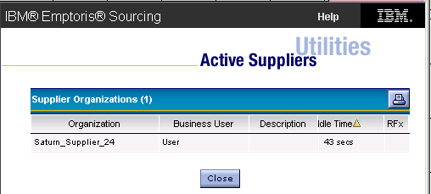
Other Topics
Starting in V10.0.1, you can have a read-only view of completed Projects from pre-V10 levels of Sourcing that have been migrated to V10.0.1. Access them via Utilities > Manage Projects. (Project Management support in Sourcing was replaced by the SSM Program Management application.)
To get a list of active (logged in) suppliers, use Utilities > Admin > Active Suppliers in System.

Slide 22
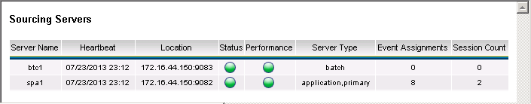
Other Topics, cont.
The Cluster Health display (Utilities > Admin > Cluster > Cluster Health) provides some insight into the status and performance of the system, including (in the Session Count column), the number of users logged in to SSM. This can only be run by a user with the Content Manager role.
There is little in the way of operational documentation for Sourcing. However, since Sourcing is a WebSphere application, much of the administration of Sourcing comes through WebSphere administration.

Slide 23
Optional Demonstration/Exercise
Optionally demonstrate some of the setup tasks such as creating a new child organization and then creating a BAM user for it.
Students will need an administration user to perform many of the tasks described here. These users are not generally made available to class students because of the possibility of damaging the system for everyone.
Performing some experiments with event imports and exports, and SSM batch uploads, are good exercises if time is available.

Slide 24
Detail Slides: VSM Batch Uploads

Slide 25
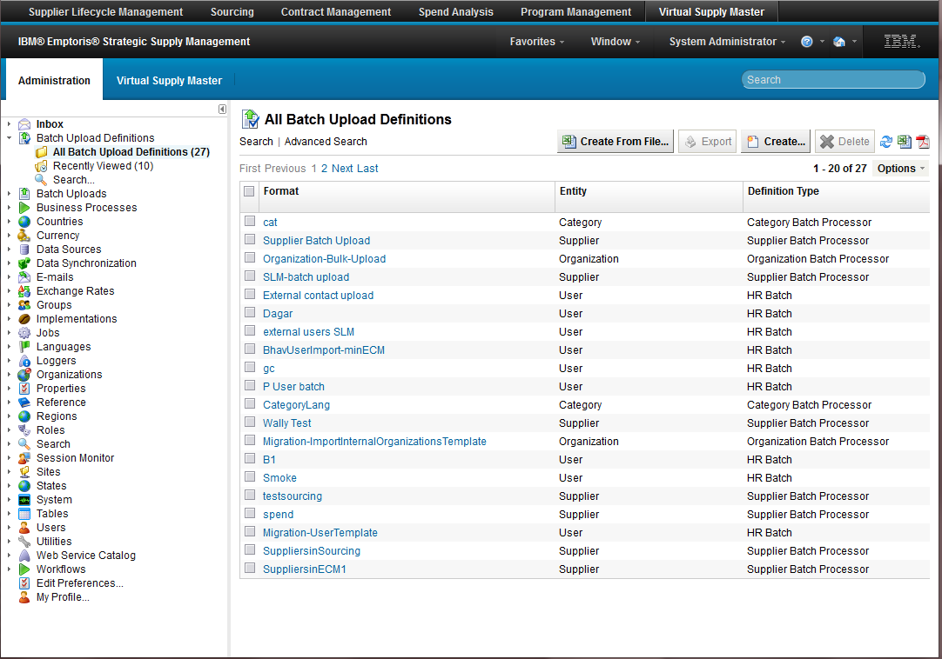
Batch Upload – How to…
Batch Uploading
If you want to import anything into the system, you must create a definition
Navigate –
  Administration
  Batch Upload Definitions
  All Batch Upload Definitions
Create…
FYI – There are no OOTB definitions
FYI - Create From File… doesn’t currently work with non-generic processors – Do not use

Slide 26
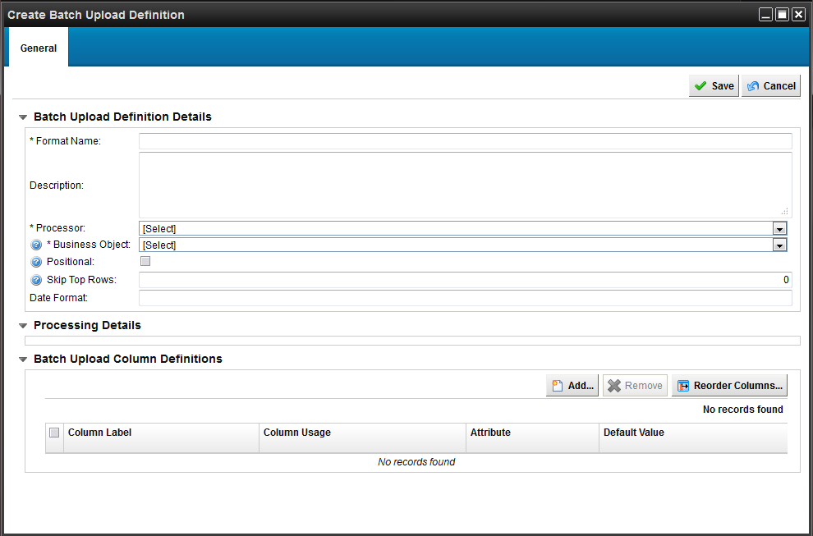
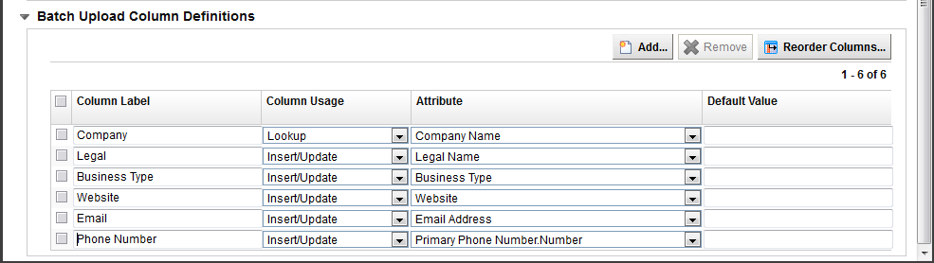
Batch Upload – How to…
Create Definition
To have the system create a template for you…
Click Create
Enter Required Name
Select the appropriate processor for your purpose
  Category
  Country
  Region
  State / Province Subdivision
  Organization
  Industry Code
  HR
  Supplier
Select the applicable Data Source
To create a custom template…
Edit column labels, usage and attributes, reorder and remove
  Lookup - Use to search uniqueness if it exists and update, otherwise insert
  Insert / Update
  Ignore
Save
FYI –
Be cognizant of your required fields for an object as the definition creation will not warn you, otherwise the system will throw errors when performing the Upload with the definition
org.hibernate.exception.ConstraintViolationException: Could not execute JDBC batch update

Slide 27
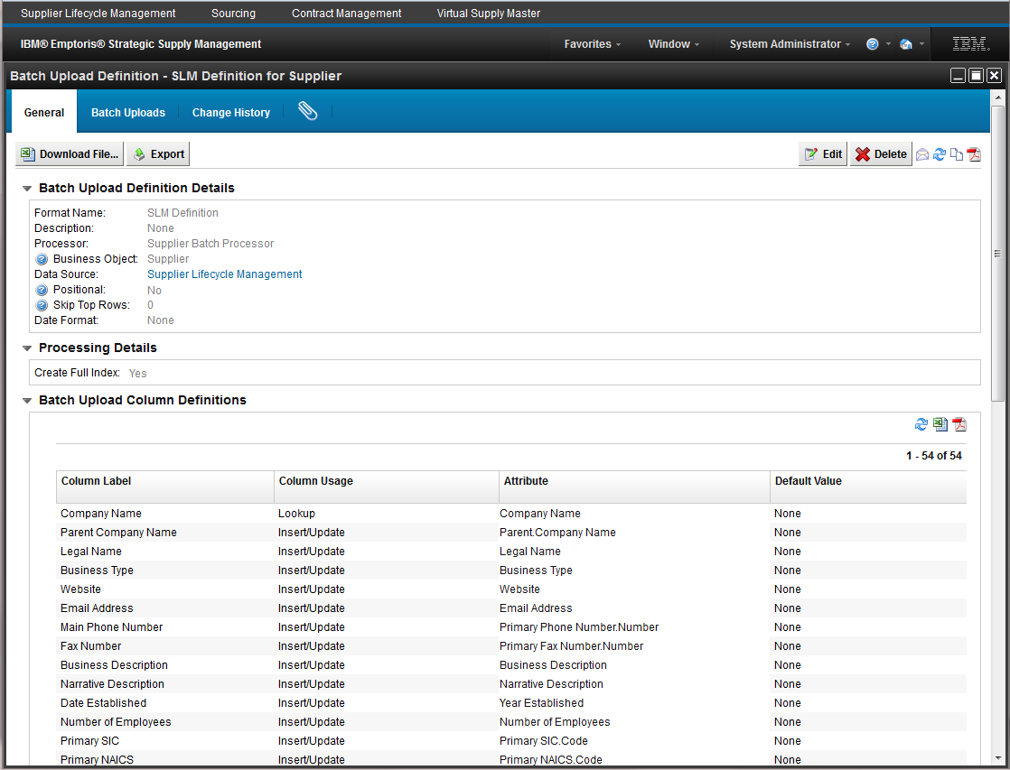
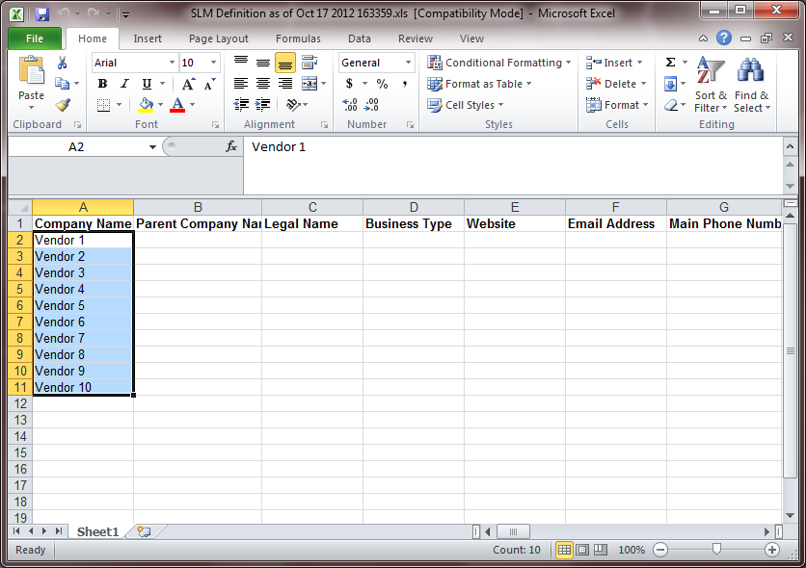
Batch Upload – How to…
Download
Click
  Download File…
Save to local machine
Update your file and save
FYI – We currently do not support XLSX (2010) format
  Only XLS and CSV

Slide 28
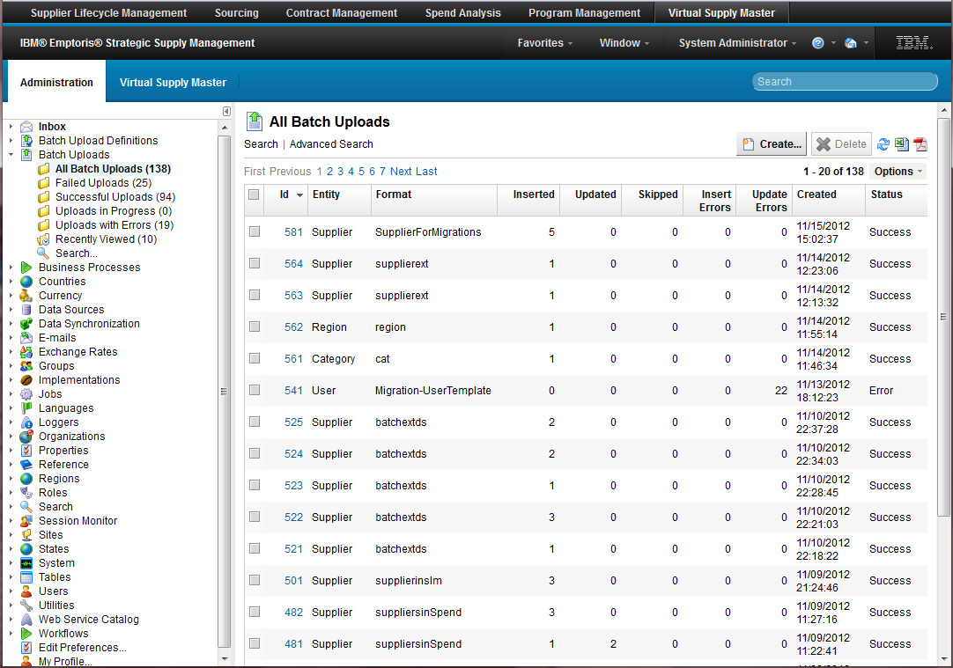
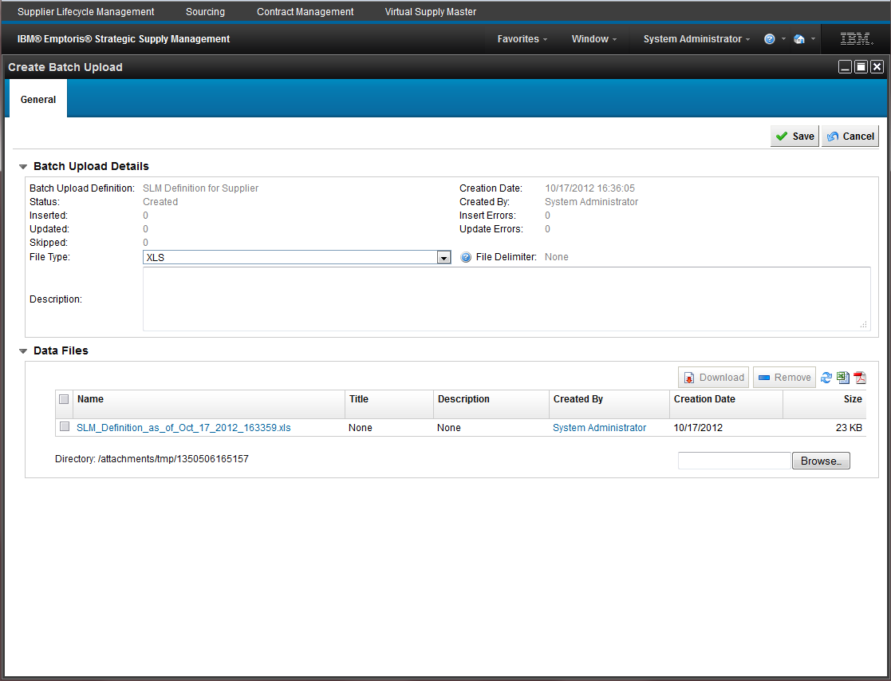
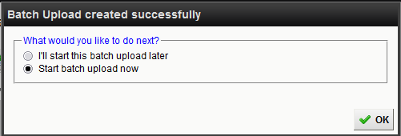
Batch Upload – How to…
Upload
Navigate –
  Administration
  Batch Uploads
  All Batch Uploads
Create…
Select the appropriate batch upload definition
Browse…
  Your local machine
Save
Schedule to run now or later
  Later places the upload in “Created” status

Slide 29
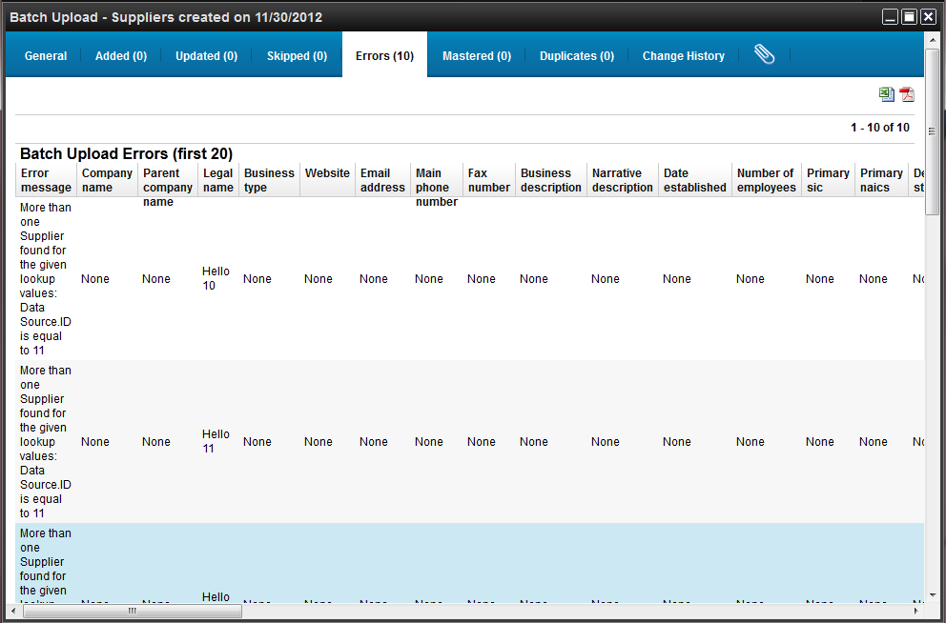
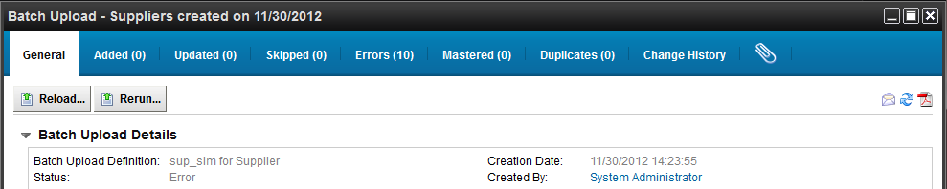
Batch Upload – How to…
Export – Error File and Reload
Navigate to the completed process
Go to Errors tab
Click the spreadsheet icon
Save to local
Delete Error Message column
Fix rows and save
General tab – Reload…
Browse…
  Your local machine
Save
Schedule to run now or later
Notes:
You can set up– do a lookup field;
Updates/insert

Slide 30
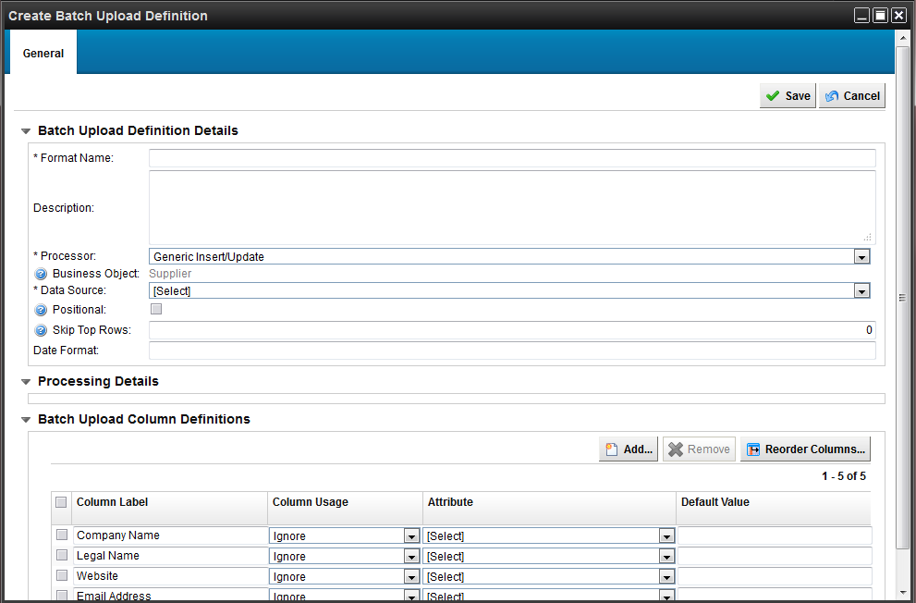
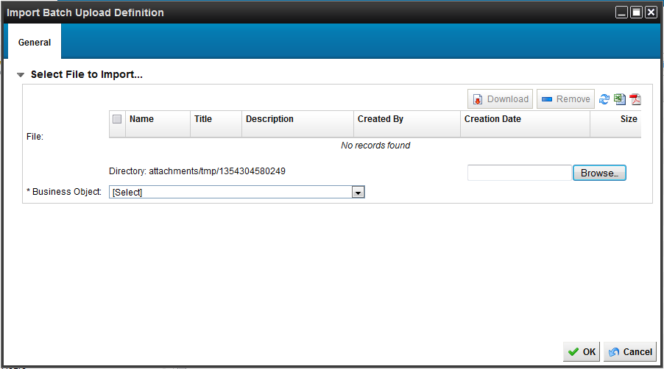
Batch Upload – How to…
Create Definition From File
To have the system create a template for you based off your own file…
Click Create From File…
Browse…
  Your local machine
Select the appropriate Business Object
Click OK
Enter Required Name
Select the appropriate processor for your purpose
Select the applicable Data Source
Edit column usage and select mapped attribute
  Lookup
  Insert / Update
  Ignore
Save

Slide 31

Questions?

